Slide 1
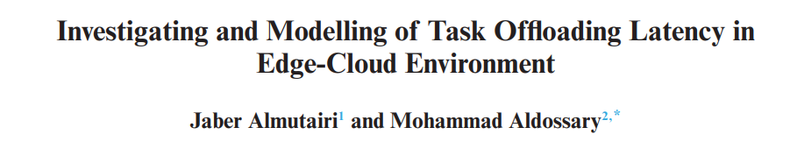
Mathematical formulations for task-offloading
in Edge-Cloud Environment

Slide 2
Investigating and Modelling of Task Offloading Latency in Edge-Cloud Environment
The Edge-Cloud system architecture that supports scheduling offloading tasks of IoT applications in order to minimize the enormous amount of transmitting data in the network. Also, it introduces the offloading latency models to investigate the delay of different offloading scenarios/schemes and explores the effect of computational and communication demand on each one. Shows that different offloading decisions within the Edge-Cloud system can lead to various service times due to the computational resources and communications types and research on task offloading issues in the Edge-Cloud environment.

Slide 3
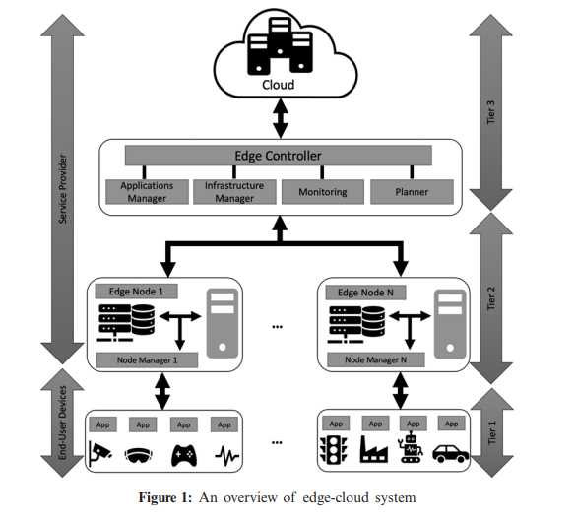
System Architecture: The Edge Controller(EC)
Edge Controller (EC) is also called Edge Orchestrator, which is a centralized component responsible for planning, deploying and managing application services in the Edge-Cloud system.
EC communicates with other components in the architecture to know the status of resources in the system (e.g., available and used), the number of IoT devices, their applications’ tasks and where IoT tasks have been allocated (e.g., Edge or Cloud).
EC consists of the following components: Application Manager, Infrastructure Manager, Monitoring and Planner.
The location of the Edge Controller can be deployed in any layer between Edge and Cloud.
For example, EC act as an independent entity in the edge layer that manages all the edge nodes in its control. It is also responsible for scheduling the offloading tasks in order to satisfy applications’ users and Edge-Cloud System requirements. The EC is synchronizing its data with the centralized Cloud because if there is any failure, other edge nodes can take EC responsibility from the cloud .

Slide 4
System Architecture: Application Manager
The application manager is responsible for managing applications running in the Edge-Cloud system. This includes requirements of application tasks, such as the amount of data to be transferred, the amount of computational requirement (e.g., required CPU) and the latency constraints. Besides, the number of application users for each edge node.
Infrastructure Manager The role of the infrastructure manager is to be in charge of the physical resources in the entire Edge-Cloud system. For instance, processors, networking and the connected IoT devices for all edge nodes.
Edge-Cloud is a virtualized environment; thus, this component responsible for the VMs as well. In this context, this component provides the EC with the utilization level of the VMs.
Monitoring The main responsibility of this component is to monitoring application tasks (e.g., computational delay and communication delay) and computational resources (e.g., CPU utilization) during the execution of applications’ tasks in the Edge-Cloud system. Furthermore, detecting the tasks’ failures due to network issues or the shortage of computational resources.
Planner The main role of this component is to propose the scheduling policy of the offloading tasks in the Edge-Cloud system and the location where they will be placed (e.g., local edge, other edges or the cloud). This offloading tasks works on this component and passes its results to EC for execution.

Slide 5
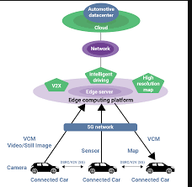
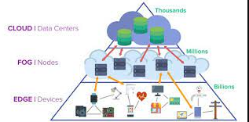
Latency Sensitive Applications
Latency-sensitive applications have high sensitivity to any delays accrue in communication or computation during the interaction with the Edge-Cloud system.
For instance, the IoT device sends data to the point that processing is complete at the edge node or the cloud in the back end of the network, and the subsequent communications are produced by the network in response to receive the results.
For example, self-driving cars consist of several services, classified these services in categories based on their latency-sensitivity, quality constraints and workload profile (required communication and computation).
First, critical applications, which must be processed in the car’s computational resources, for instance, autonomous driving and road safety applications.
Second, high-priority applications, which can be offloaded but with minimum latency, such as image aided navigation, parking navigation system and traffic control.
Third, low-priority applications, which can be offloaded and not vital as high-priority applications (e.g., infotainment, multimedia, and speech processing).

Slide 6
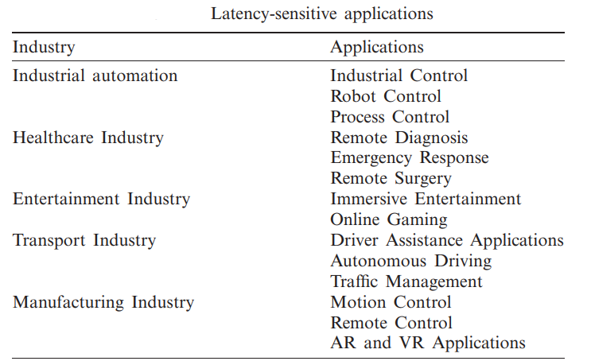

Slide 7
Latency Models
Modelling the various offloading decisions for IoT tasks that can increase the Quality of Service (QoS).
With the increasing number of IoT devices, the amount of produced data, the need for an autonomous system that requires a real-time interaction as well as the lake of support from the central Cloud due to network issues; service time has been considered as one of the most important factors to be handled in Edge Computing.
One of the main characteristics of Edge Computing is to reduce the latency level.
Additionally, using Edge Computing will enhance application performance in terms of overall service time comparing to the traditional Cloud system.
However, different offloading decisions within the Edge-Cloud system can lead to various service time due to the computational resources and communications types. The current real-world applications measure the latency between the telecommunication service provider and the cloud services.
compare the latency between offloading to the edge or the cloud, latency between multiple edge nodes that work collectively to process the offloading tasks. investigating the latency of the Edge-Cloud system is an essential step towards developing an effective scheduling policy.
Firstly, task allocation in the Edge-Cloud system is not only two choices (e.g., either at IoT device or in the cloud), but could be on any edge nodes. Moreover, edge nodes connected in a loosely coupled way on heterogeneous wireless networks (i.e., WLAN, MAN and WAN), making the process of resource management and the offloading decision more sophisticated.
Secondly, given that task processing is allocated among multiple edge nodes working collectively and the cloud, it is challenging to make an optimal offloading decision. The latency models to investigate the delay of different offloading scenarios/schemes.
Also, it explores the effect of computational and communication for each offloading scenario/scheme, which are: (1) offloading to the local edge, (2) offloading to the local edge with the cloud and (3) offloading to the local edge, other available edge nodes and the cloud. The list of the latency models’ parameters and their notations are shown i

Slide 8

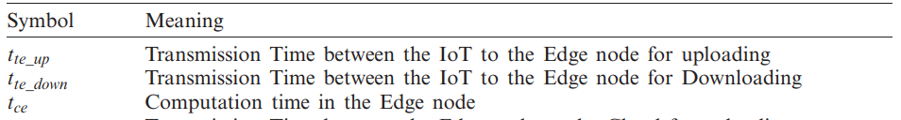
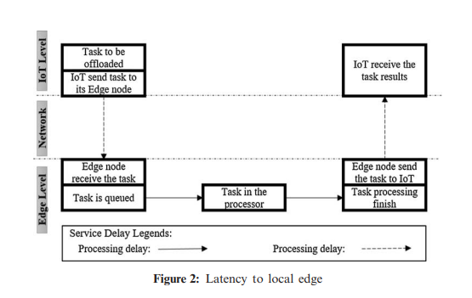
Latency Models: Latency to Local Edge
This is known as a one-level offloading system, which is basically offloading to “Cloudlet” or “Local Edge”.
It aims to provide a micro-data center that supports IoT devices within a specific area such as a coffee shop, mall center and airport .
Thus, IoT devices can offload their tasks to be processed on the edge or cloud, as an example.
This offloading scenario/scheme provides ultra-low latency due to the avoidance of network backhaul delays. The end-to-end service time composed of two delays, network delay and computational delay.
The network delay consists of the time of sending the data to the edge and the time to receive the output from the edge to the IoT device.
The computation time is the time from arriving the task to the edge node until the processing has completed. Therefore, the end-to-end service time latency is the sum of communication delay and computational delay, which can be calculated as follows:
To clarify, IoT devices send their offloading tasks through the wireless network, and then the tasks will be processed by the edge node and finally send the results to IoT devices,

Slide 9

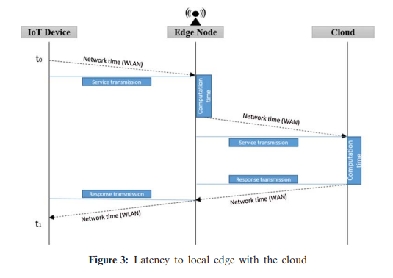
Latency Models: Latency to Local Edge with the Cloud
In this offloading scenario/scheme, rather than relying on only one Edge node, the IoT tasks can be processed collaboratively between the connected Edge node and the cloud servers.
This will combine the benefits of both Cloud and Edge Computing, where the cloud has a massive amount of computation resources, and the edge has lower communication time.
In this scenario/scheme, the edge can do part of the processing such as pre-processing, and the rest of the tasks will be processed in the cloud.
IoT sends the computation tasks to the connected edge and then part of these tasks forwarded to the cloud.
Once the cloud finishes the computation, it will send the result to the edge, and the edge will send it to the IoT devices.
This scenario/scheme consists of communication time (e.g., the time between the IoT device to the edge node and the time between edge nodes to the cloud) and computation time (e.g., processing time in the edge and processing time in the cloud). Thus, the end-to-end service time can be calculated as follows:

Slide 10

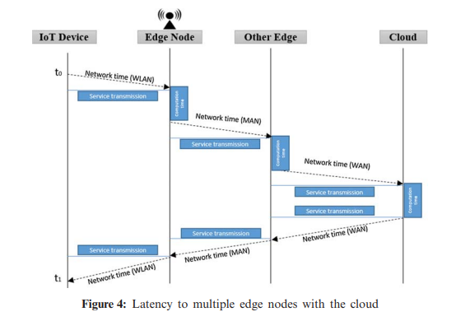
Latency Models: Latency to Multiple Edge Nodes with the Cloud
This is known as a three-level offloading scenario/scheme that aims to utilize more resources at the edge layer and support the IoT devices in order to reduce the overall service time.
It adds another level by considering other available computation resources in the edge layer.
Basically, it distributes IoT tasks over three levels: connected edge, other available edge nodes and the cloud. The edge controller (edge orchestrator) controllers all edge servers by Wireless Local Area Network (WLAN) or Metropolitan Area Network (MAN), which have low latency compared to Wild Area Network (WAN). This will help to decrease the dependency of cloud processing as well as increase the utilization of computing resources at the edge. This scenario/scheme consists of communication time (e.g., the time between the IoT device to the edge node, the time between edge node to other collaborative edge node and the time between edge nodes to the cloud) and computation time (e.g., processing time in the edge, processing time in other collaborative edge node and processing time in the cloud). Thus, the end-to-end service time can be calculated as follows:
IoT sends the computation tasks to the connected edge and then part of these tasks transferred to other available resources in the edge level through the edge controller and the rest to the cloud.

Slide 11
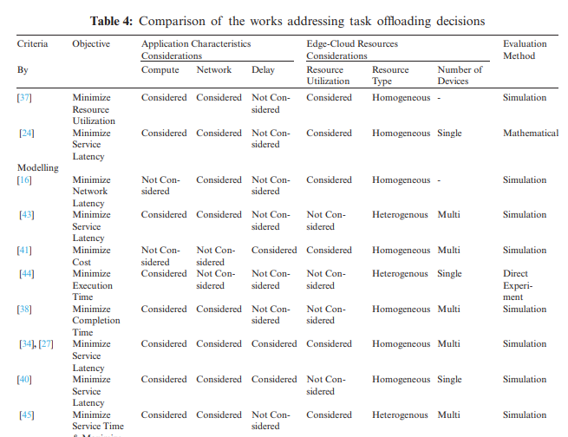
Investigating and Modelling of Task Offloading Latency in Edge-Cloud Environment

Slide 12
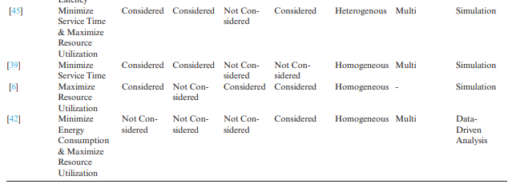
Investigating and Modelling of Task Offloading Latency in Edge-Cloud Environment
Reference
Almutairi, Jaber, and Mohammad Aldossary. "Investigating and modelling of task offloading latency in edge-cloud environment." Comput., Mater. Continua 68.3 (2021): 4143-4160.

